Slide 1
Österreichisches Sprachdiplom
Deutsch
... internationally recognised German exams
20
23

Slide 2
For a
sustainable future
... innovative und digital
20
23

Slide 3
AGENDA
01 | About ÖSD
02 | Pluricentricity – three countries, one certificate
03 | ÖSD examination system
04 | E-Testing
05 | Projects and international cooperations
06 | Advantages of the ÖSD certificate
07 | ÖSD exam centre

Slide 5
Österreichisches
Österreich (Austria)
Sprachdiplom
Schweiz (Switzerland)
Deutsch
Deutschland (Germany)

Slide 6
Österreichisches
Sprachdiplom
Deutsch
Österreich
Schweiz
Deutschland
founded in 1992/1993 since 2009, independent non-profit association with 2 locations (Vienna & Klagenfurt)
internationally recognized examination system for German as a foreign and second language
standardized assessment tests, course-independent, criteria-oriented
ÖSD examinations are based on the Common European Framework of Reference for Languages (Europarat) and Profile deutsch
Over 400 examination centres in more than 60 countries with more than 110,000 examinations annually

Slide 7
Österreichisches
Sprachdiplom
Deutsch
Österreich
Schweiz
Deutschland
standardized assessment tests, course-independent, criteria-oriented
ÖSD examinations are based on the Common European Framework of Reference for Languages (Europarat) and Profile deutsch
Over 400 examination centres in more than 60 countries with more than 110,000 examinations annually

Slide 8
Österreichisches
Sprachdiplom
Deutsch
Österreich
Schweiz
Deutschland
Over 400 examination centres in more than 60 countries with more than 100,000 examinations annually

Slide 9
Austria
Albania
Armenia
Azerbaijan
Belarus
Bosnia & Herzegovina
Brazil
Bulgaria
China
Cameroon
Colombia
Croatia
Czech Republic
Estonia
Georgia
Greece
Great Britain
Guatemala
Hungary
India
Iran
Italy
Japan
Jordan
Kazakhstan
Kyrgyzstan
Kosovo
Liechtenstein
Malaysia
Morocco
Macedonia
Mexico
Moldova
Montenegro
Nepal
Nicaragua
Philippines
Poland
Romania
Russia
Sweden
Switzerland
Serbia
Slovakia
Slovenia
South Korea
Taiwan
Tunisia
Turkey
Ukraine
USA
United Arab Emirates
Vietnam
More than 60 countries
Licence agreements with
Universities
Schools
Language schools
Adult education institutions
Show countries

Slide 10
MEMBERSHIPS, awards & certifications
Board of trustees and scientific advisory board
Representatives from ministries, universities and GFL/GSL institutes, language course providers (VHS/VÖV, Campus Austria), OeAD and ÖDaF
Full member of the Association of Language Testers in Europe
ALTE unites language test providers to promote fair and accurate language proficiency assessment in Europe and worldwide.
https://www.alte.org

Slide 11
Winner of the "European Label for Innovative Language Initiatives"
Member of the European Association for Language Testing and Assessment (EALTA)
EALTA is a professional organization for language testers in Europe.
https://www.ealta.eu.org

Slide 12
Pluricentricity – three countries, one certificate
Österreich (Austria)
Schweiz (Switzerland)
Deutschland (Germany)

Slide 13
Österreichisches
Sprachdiplom
Deutsch
Österreich
Schweiz
Deutschland
The ÖSD supports the pluricentric view of languages:
All standard varieties of German as spoken in Austria, Germany and Switzerland are seen as equally important.
The aim is to raise awareness of national standard varieties and to prepare participants for the linguistic reality and linguistic-cultural diversity in German-speaking countries (DACH region).
D → Deutschland (Germany)
A → Österreich (Austria)
CH → Schweiz (Switzerland)
Liechtenstein, East Belgium, Luxembourg and South Tyrol are included
Internationally recognized examination system!
Notes:
Der ÖSD unterstützt die plurizentrische Sicht: dies bedeutet, dass alle Standardvarietäten des Deutschen, wie sie in Ö, D und der S gesprochen werden, als gleichwertig angesehen werden.
Das Hauptziel des ÖSD ist es, das Bewusstsein für die nationalen Standardvarietäten zu schärfen und die Teilnehmer auf die sprachliche Realität und die kulturelle Vielfalt in den deutschsprachigen Ländern im sogenannten DACH-Raum (Deutschland, Österreich, Schweiz) vorzubereiten. Darüber hinaus berücksichtigt der ÖSD auch Länder wie Liechtenstein, Ostbelgien, Luxemburg und Südtirol in dieser sprachlichen Vielfalt. Dies fördert die Wertschätzung für die verschiedenen regionalen Variationen der deutschen Sprache.

Slide 14
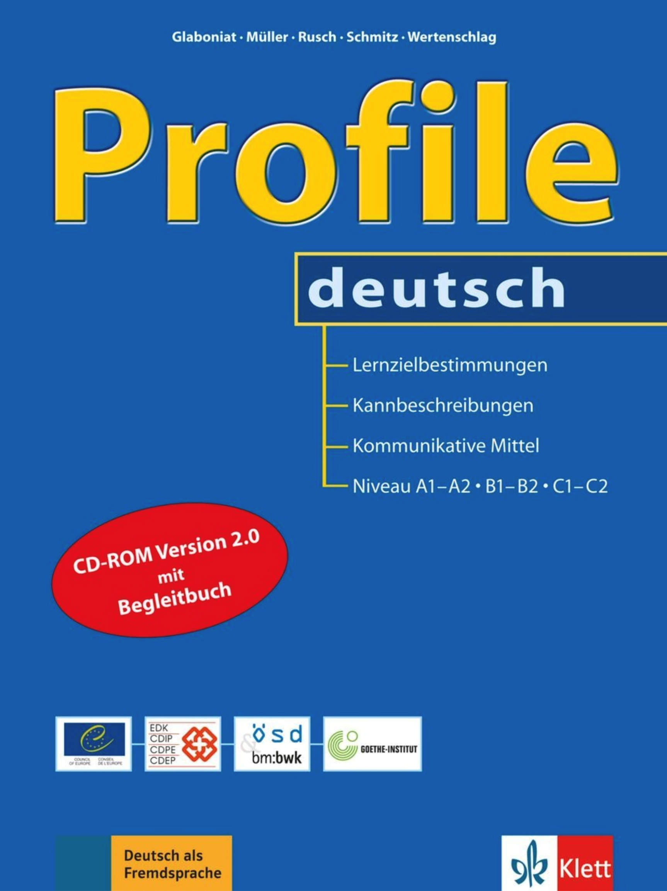
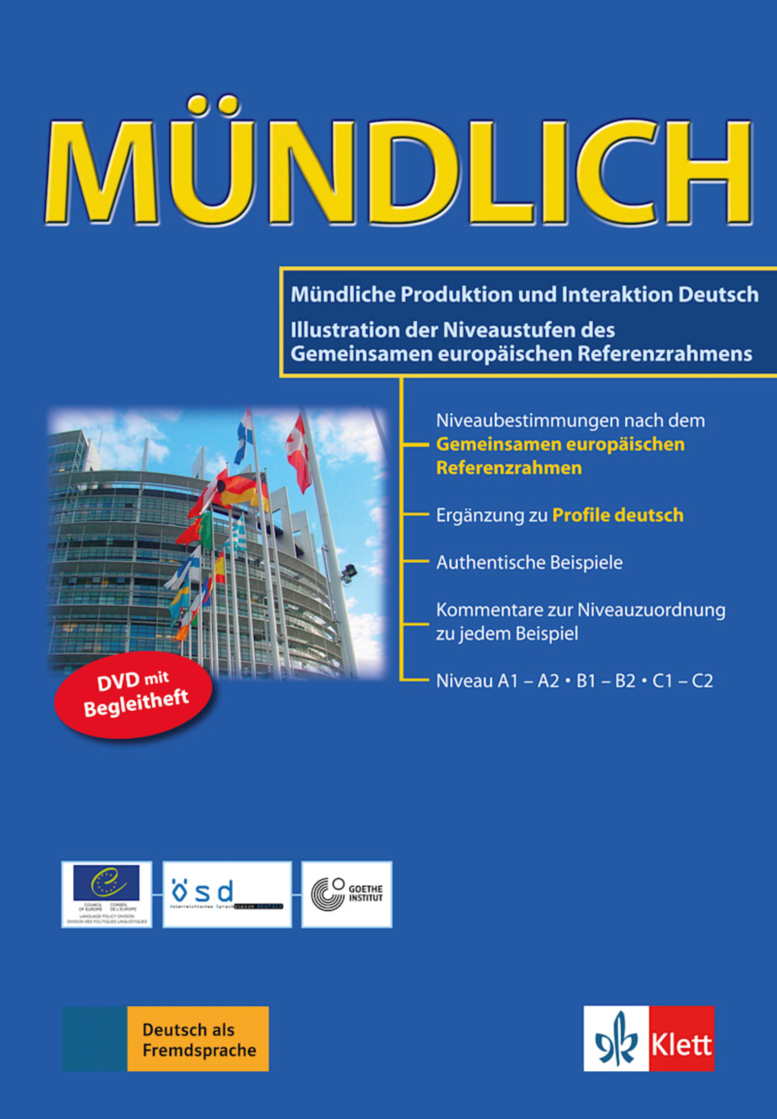
From CEFR (cross-language) to Profile deutsch
Collaboration in the translation of the Common European Framework of Reference for Languages (CEFR)
Collaboration on Profile deutsch, the concretization of the CEFR for the German language
Collaboration on MÜNDLICH, an illustration of the CEFR levels for the speaking sector
Notes:
About the Common European Framework of Reference for Languages (CEFR) The Common European Framework of Reference for Languages (CEFR) is an international standard for describing language ability.

Slide 15
Gemeinsamer europäischer Referenzrahmen für Sprachen (GER)
definiert allgemein sprachliche Aktivitäten und Kompetenzen in einer breit angelegten Palette von Situationen und Themen für alle europäischen Sprachen als Fremdsprachen auf allen Sprachniveaus (A1 bis C2) und für eine allgemeine und breit angelegte Gruppe von erwachsenen Lernenden.
Profile Deutsch (Pd)
setzt die allgemeinen Beschreibungen des Referenzrahmens für die Sprache Deutsch um, d.h. es liefert die für die Erfüllung der jeweiligen Kompetenzbeschreibungen notwendigen sprachlichen Mittel (Sprachhandlungen, allgemeiner und thematischer Wortschatz, Grammatik) in deutscher Sprache für eine allgemeine und breit angelegte Gruppe von Lernenden.
ÖSD-Zertifikat / Prüfungsziele
definiert ausgewählte Prüfungsziele für die jeweiligen Zielgruppen auf den jeweiligen Niveaus und enthält dafür relevante Inventare (Wortschatzliste, Grammatik).
Zertifikat B1 / Testformat
überprüft den Kernbereich der Prüfungsziele für die beschriebenen Zielgruppen auf dem Niveau B1
Manuela Glaboniat, Michaela Perlmann-Balme, Thomas Studer.
Zertifikat B1. Deutschprüfung für Jugendliche und Erwachsene.
Prüfungsziele, Testbeschreibung. Hueber Verlag GmbH & Co KG, 2013
ISBN-10: 3190318689; ISBN-13: 978-3190318681

Slide 16
A1
A2
B1
B1
B2
C1
C2
ÖSD examination
system
standardised
criteria-orientated
internationally recognised

Slide 17
The ÖSD examination system
Childrend from 10 years
Teenagers from 12 years
Teenagers from 14 years
Adults from 16 years
* is offered in four modules
INTERNATIONAL
AUSTRIA VERSION
A1
ÖSD KID A1
ÖSD KID A1
ÖSD Certificate A1
ÖSD Certificate A1
ÖSD Certificate A1 Austria
Elementary use of language
A2
ÖSD KID A2
ÖSD KID A2
ÖSD Certificate A2
ÖSD Certificate A2
ÖSD Certificate A2 Austria
B1
ÖSD Certificate B1 Teenagers
(modular)*
ÖSD Certificate B1 Teenagers
(modular)*
ÖSD Certificate B1 (modular)*
Independent use of language
B1
ÖSD Certificate German Austria B1 Teenagers
ÖSD Certificate German Austria B1 Teenagers
ÖSD Certificate German Austria B1

Slide 18
The ÖSD examination system
Childrend from 10 years
Teenagers from 12 years
Teenagers from 14 years
Adults from 16 years
* is offered in four modules
INTERNATIONAL
AUSTRIA VERSION
B2
ÖSD Certificate B2 Teenagers
ÖSD Certificate B2
ÖSD Certificate B2 Austria
Independent use of language
B2
ÖSD Certificate B2 Nursing and Medical Professions
C1
ÖSD Certificate C1 Teenagers
ÖSD Certificate C1
C2
ÖSD Certificate C2 (modular)*
Competent use of language
ÖSD Certificate C2 Business Language German

Slide 19
The ÖSD examination system
Childrend from 10 years
Teenagers from 12 years
Teenagers from 14 years
Adults from 16 years
* is offered in four modules
INTERNATIONAL
AUSTRIA VERSION
B2
ÖSD Certificate B2 Teenagers
ÖSD Certificate B2
ÖSD Certificate B2 Austria
Independent use of language
B2
ÖSD Certificate B2 Nursing and Medical Professions
From 2024
C1
ÖSD Certificate C1 Teenagers
ÖSD Certificate C1
C2
ÖSD Certificate C2 (modular)*
Competent use of language
ÖSD Certificate C2 Business Language German

Slide 20
Exam Modules
Since 2019, all ÖSD exams have been offered on a modular basis, i.e. the exam modules (two or four modules) can be taken independently of each other at different times:
2 Modules
For more info - view Sample paper!
Reading
Listening
Writing
Speaking
Written exam
Oral exam

Slide 21
Exam Modules
Since 2019, all ÖSD exams have been offered on a modular basis, i.e. the exam modules (two or four modules) can be taken independently of each other at different times:
4 Modules
Reading
Listening
Writing
Speaking
Applies only to the exams - Certificate B1 (ZB1) - Certificate C2 (ZC2)

Slide 22
Recognition of the ÖSD exam
ÖSD certificates serve as proof of German language proficiency and are in demand and recognized internationally:
on the labour market at universities and other educational institutions for official procedures such as integration, visa (family reunification), etc.
On our website you will find a list of universities and their level requirements.
LINK: https://www.osd.at/die-pruefungen/anerkennung-von-oesd-pruefungen/
* Please contact the respective institution in advance to find out what language level is required.

Slide 23
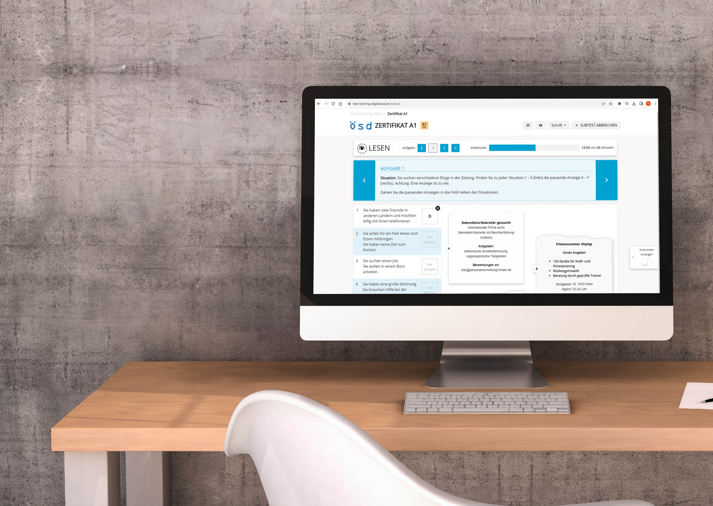
E-testing
faster EVALUATION faster RESULTS faster PROCESSING

Slide 24
Bring Your Own Device (BYOD): Taking the exam on a laptop / computer
Modern design (TTD) and user-friendly test format
Execution and assessment of the oral exam in digital form, with integrated video-call (Zoom)
ADVANTAGE: Different variations of settings possible, e.g. Participants and 1 examiner on site, 1 examiner from Austria

Slide 25
ÖSD-Zertifikat
Vorteile
Separate app for organization and supervision
Scheduling and room planning at a glance, Resource-saving
More safety (no shipping), sustainable & environmentally friendly

Slide 26
ÖSD certificate Advantages
for students for examiners for institutions

Slide 27
Opens up new opportunities In German-speaking countries, ÖSD certificates are used as proof of German language skills, both for residence permits and for university admissions and the job market.
Advantages for students
Pluricentricity - three countries, one certificate The standard varieties of the German-speaking countries (Austria – Switzerland – Germany) are considered equivalent and will be taken into account in the examinations.
Quality that speaks for itself ÖSD examinations meet the highest quality standards and are regularly subjected to strict scientific evaluations.
Digitally supported preparation With the digital test training, the online practice exam and our model sets, it is also possible to prepare for the ÖSD exam online at any time.
Notes:
Teil der ÖSD-Familie weiter hinten

Slide 28
Be strong together! Our strengths include personal support, responding to the needs of our partners and supporting the marketing of your ÖSD examination centre.
Advantages for Examiners & Institution
Educational time with ÖSD The ÖSD supports you in the qualification and training of ÖSD examiners as well as in the further training of teachers.
Another step into the future With our planned innovations in the field of digital test execution, we and you are well prepared for the future.
Notes:
Qualität auf Folie 49, Punkt 2

Slide 29
Advantages for Institution
Flexible implementation conditions and licensing modalities As a licensee, you have a say in the extent to which you, as an examination centre, are involved in the examination and assessment process.
Individual solutions and cooperations We do not only develop tests and examinations according to individual needs and assignments, but we are also available for other cooperation projects in the field of language teaching, learning and testing.
Flexible pricing and no license fee for the first year In accordance with the agreed conditions and methods of implementation (status A to D), the ÖSD sets the customary sales prices per test in addition to a minimum annual licence fee.

Slide 30
ÖSD Exam CentRE
Customer-orientated
Quality-orientated
Future-orientated

Slide 31
Qualifications and general conditions
1
2
3
4
Qualified teaching staff:
Experienced teachers who fulfil the requirements of the examination profile and who participate in ÖSD examiner training after successful licensing.
Suitable premises and technology:
Availability of appropriate premises and technical equipment to ensure the smooth conduct of the examination in accordance with the examination regulations.
Demand-orientated language course offer:
A language course programme that ensures a sufficient number of participants for at least three to four examination dates per year.
Election of exam chairperson and deputy chairperson:
Appointment of a person responsible for chairing the examination and a deputy to ensure that the examinations run smoothly.

Slide 32
Opens up new opportunities–Apply for your ÖSD license now!
marketing@osd.at
Notes:
https://app.osd.at/apply

